Slide 1
Programming Fundamentals
By
Shazmeen Batool

Slide 2
Lab Task 1
Write a C++ program which counts the number of a’s in the string.

Slide 3
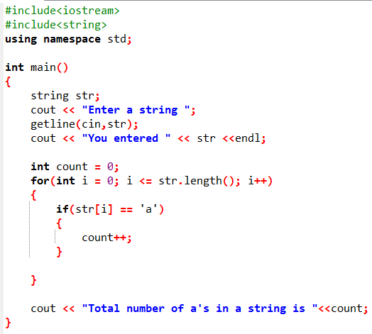


Slide 4
Lab Task 2
Write a C++ program to count the uppercase alphabets in a string.

Slide 5
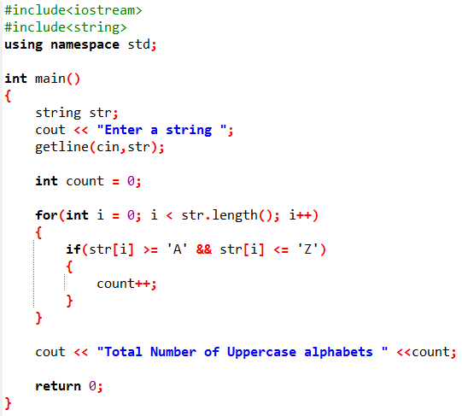


Slide 6
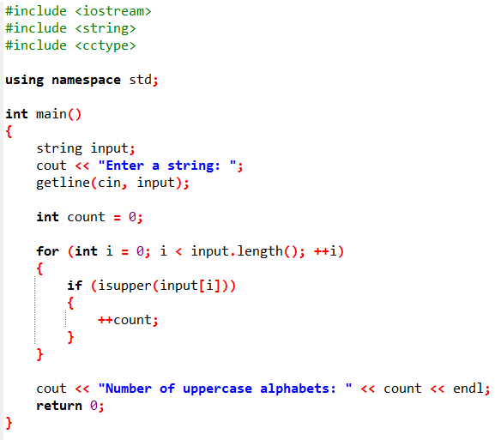


Slide 7
Lab Task 3
Write a C++ program which store names of 5 students in a string. Print the name of those students whose name start with vowels.

Slide 8
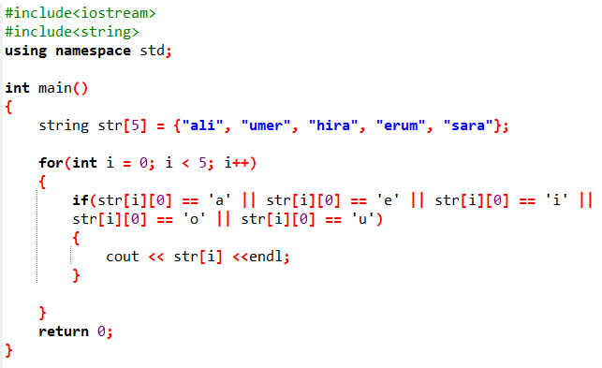

Also Practice it using C style string
What’s the issue in the above code?

Slide 9
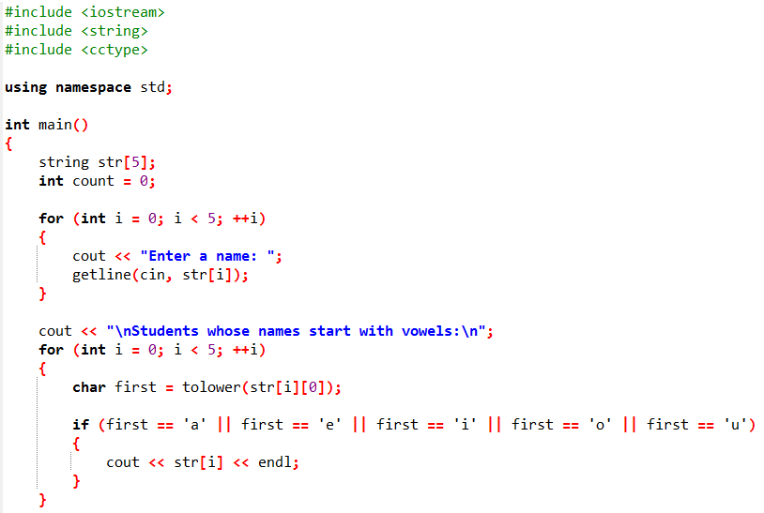
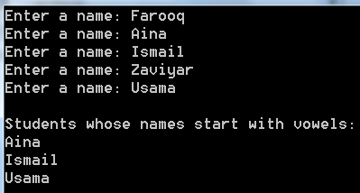

Slide 10
Lab Task 4
Write a C++ program which stores names of five cities and print the names of only those cities which start from K.

